Slide 1
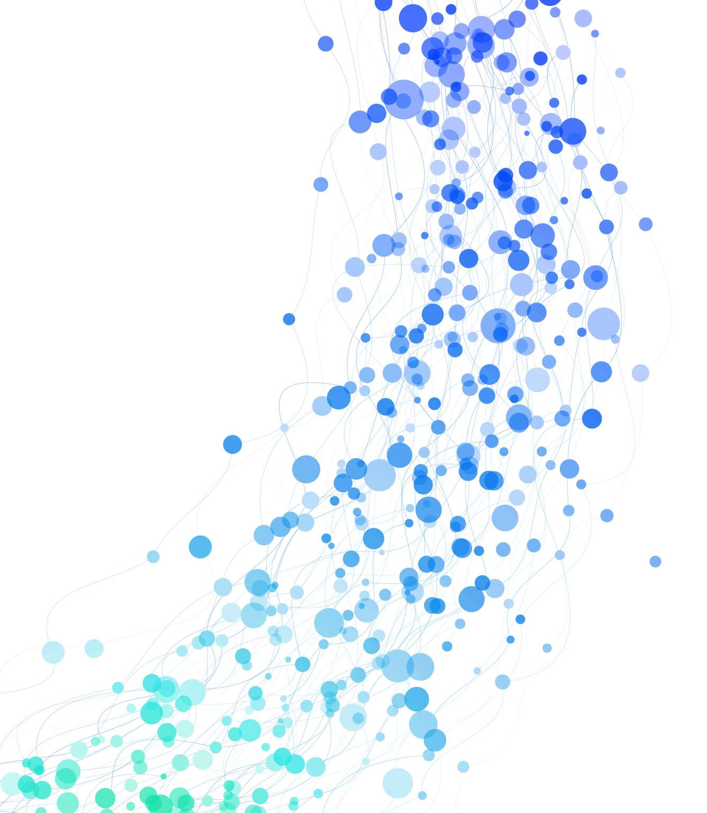
Online Shopper Intention Prediction App
Fougnigue Sefon
Master of Science in Computer Information Systems and Business Analytics
West Texas A&M University

Slide 2
Introduction

Slide 3
Overview of the Synthesis Prototype Project
Purpose
Predict purchasing intentions on e-commerce platforms
Benefit
Help retailers understand and enhance customer engagement

Slide 4

Software Systems (SS)
Python for backend development
Streamlit for web interface
Application of software development methods
System architecture insights

Slide 5
Business Analytics (BA)
Predictive modeling techniques used (logistic regression, LightGBM)
Analysis of user behavior data
Application of statistical and predictive modeling to business decisions

Slide 6
Data Management (DM)
Importance of data integrity and usability
Data preprocessing steps
Enhancement of model performance through effective data management

Slide 7
Future Enhancements
Integration of comprehensive data sources
Plans for more advanced machine learning models
Vision for the app as a robust tool integrating SS, BA, DM, and CN

Slide 8
Conclusion
Summary of project significance
Demonstration of interdisciplinary education application
Reflection on the educational experience at WTAMU

